Slide 1
ASSIGNMENT 5: Low-fi Prototyping & Pilot Usability Testing

Slide 2

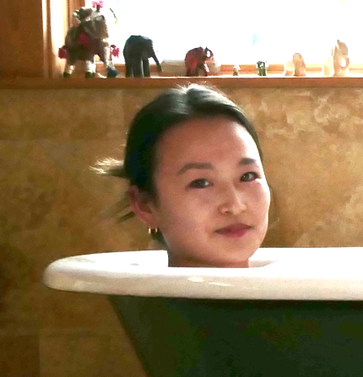
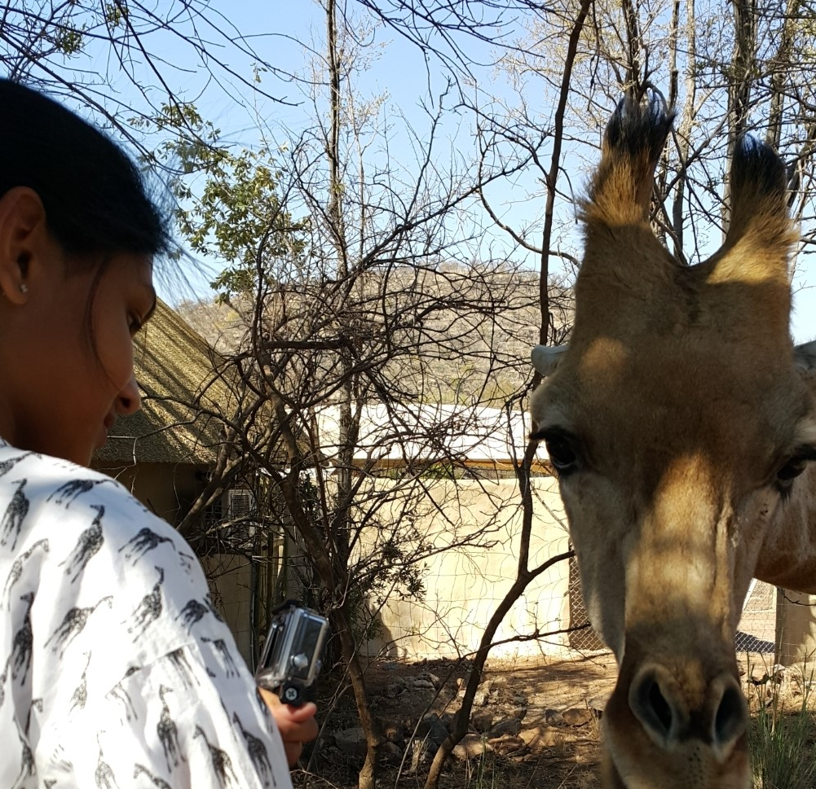
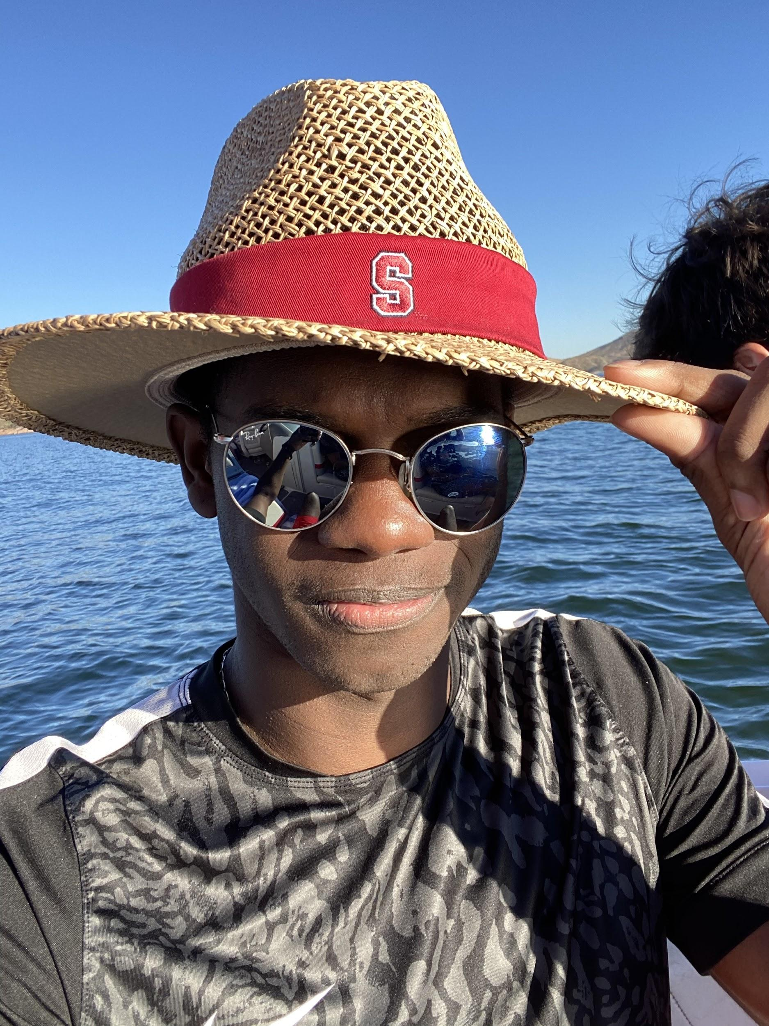
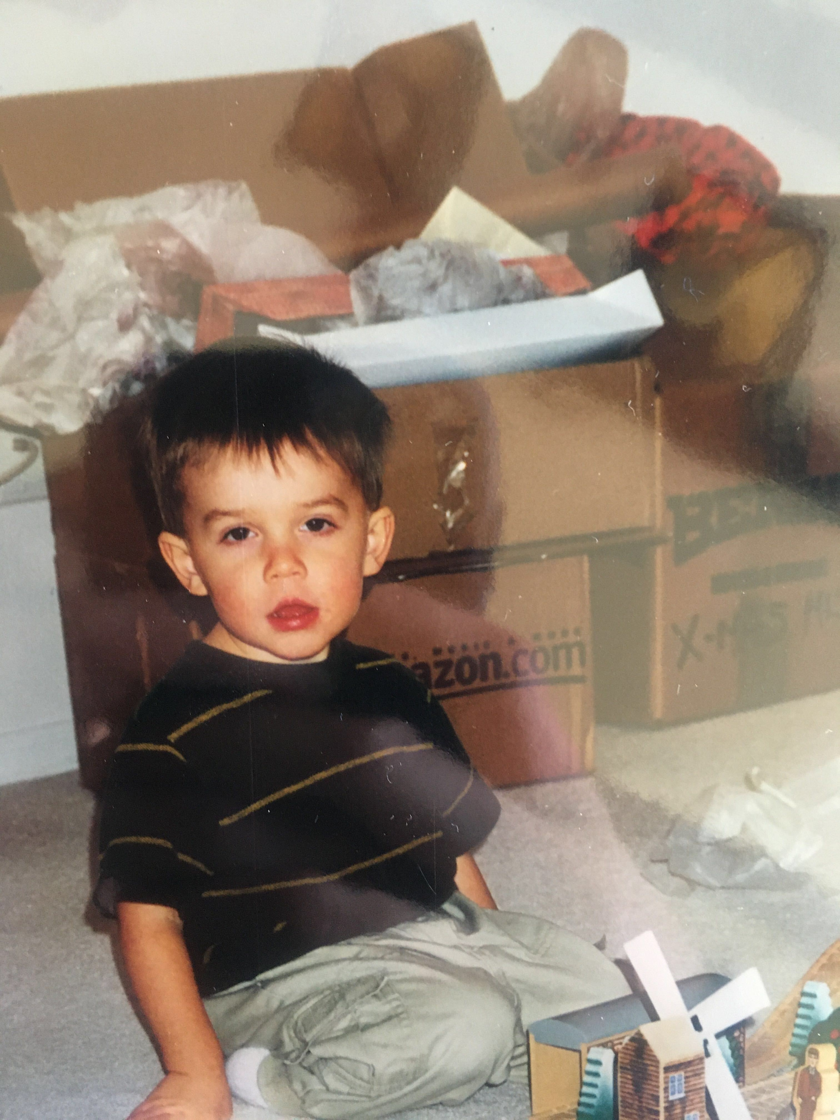
Coalease Founders
Kaili Wang Computer Science
Kiara Nirghin Computer Science
Robert Ross Computer Science
George Younger Computer Science

Slide 3
Problem & Solution Overview
Moving into a physical space is daunting & complex
Amplified for small businesses in the creative industry
Spaces are often too expensive, too large, and difficult for a single leasor
Coalease aims to bring creators under one roof, complement each other’s products, and build community

Slide 4
Mission Statement & Value Proposition
Mission Statement
Our goal is to bring the communities of creators together in order to leverage a larger group size to reduce the difficulties associated with navigating a lease for a physical space.
Value Proposition
Create with creators.

Slide 5
Selected Interface & Rationale
Type | Pro | Cons
Mobile (People Focused) | Co-leaser > Location Mobile is more conducive for communication Opportunity to improve mobile use in this area | Laptops are the preferred medium for business use People don’t typically search for real estate on their phone
Desktop (Location Focused) | Preferred method for business dealings | Loses niche due to functioning similarly to Zillow Lower engagement and less flexible notification options
We decided to pursue a people first approach on a mobile platform for our interface.

Slide 6
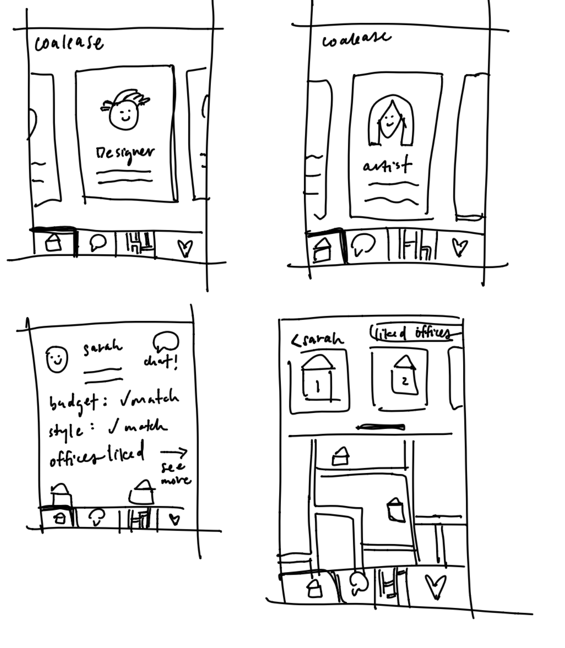
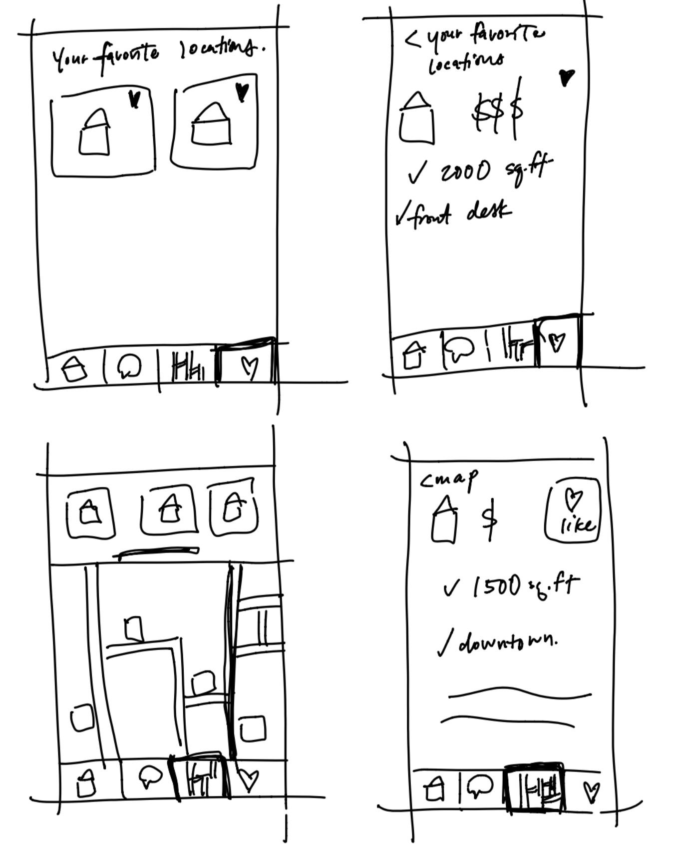
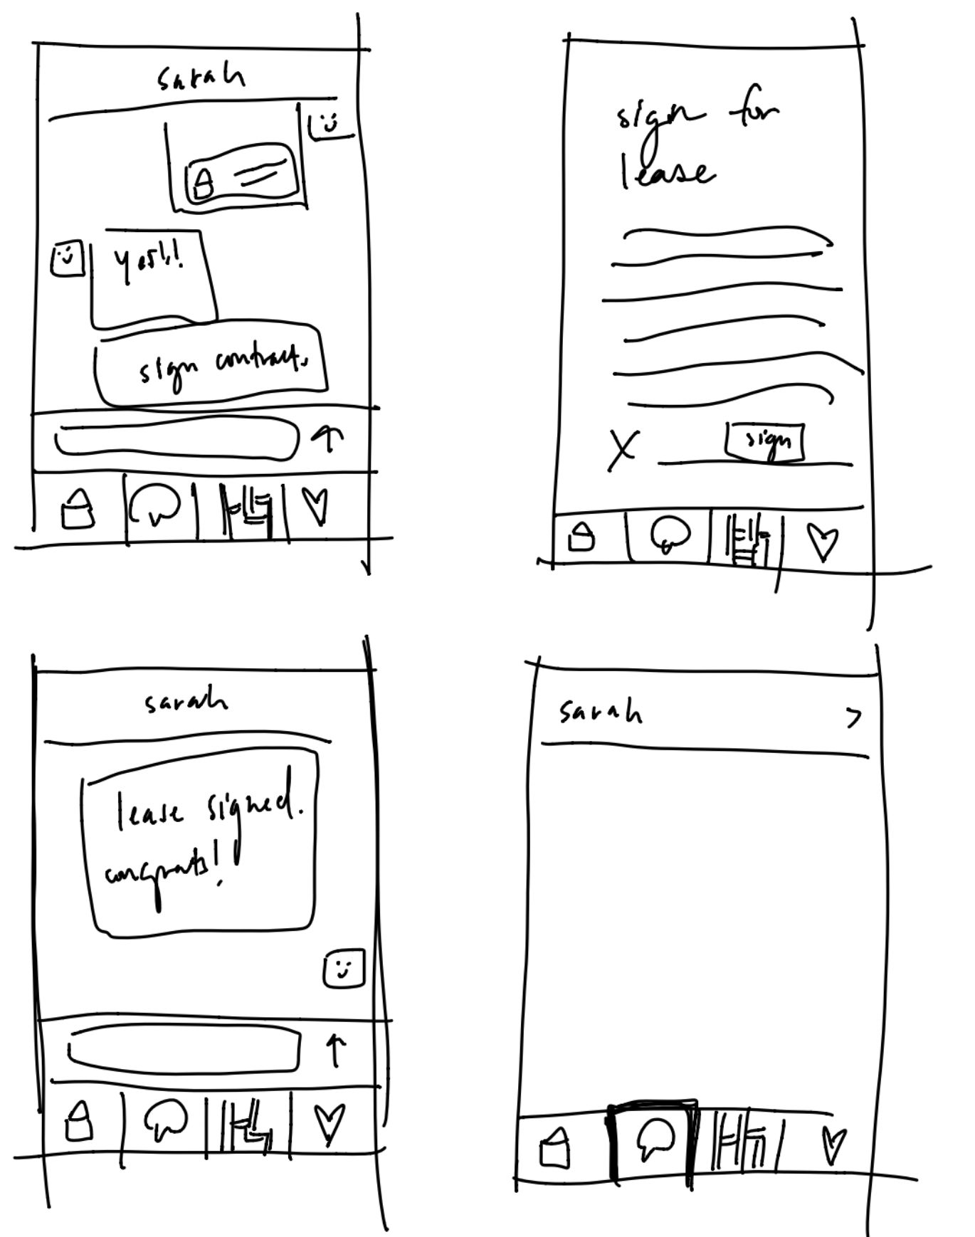
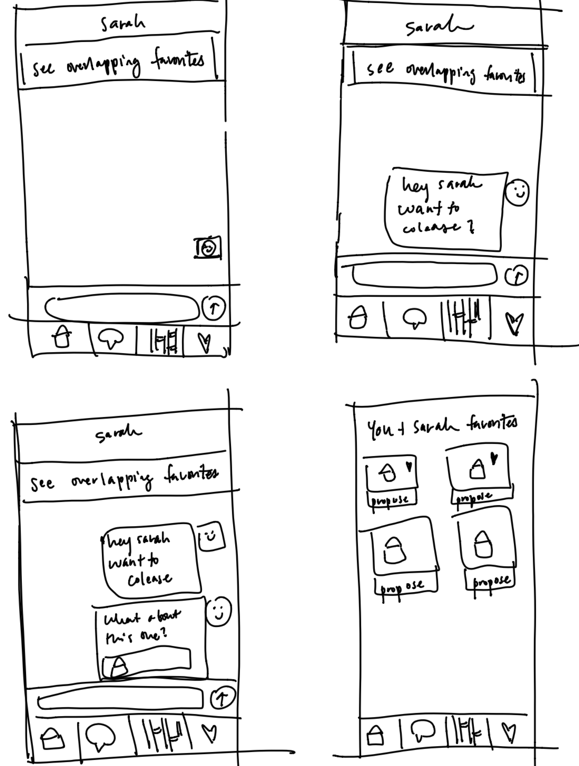
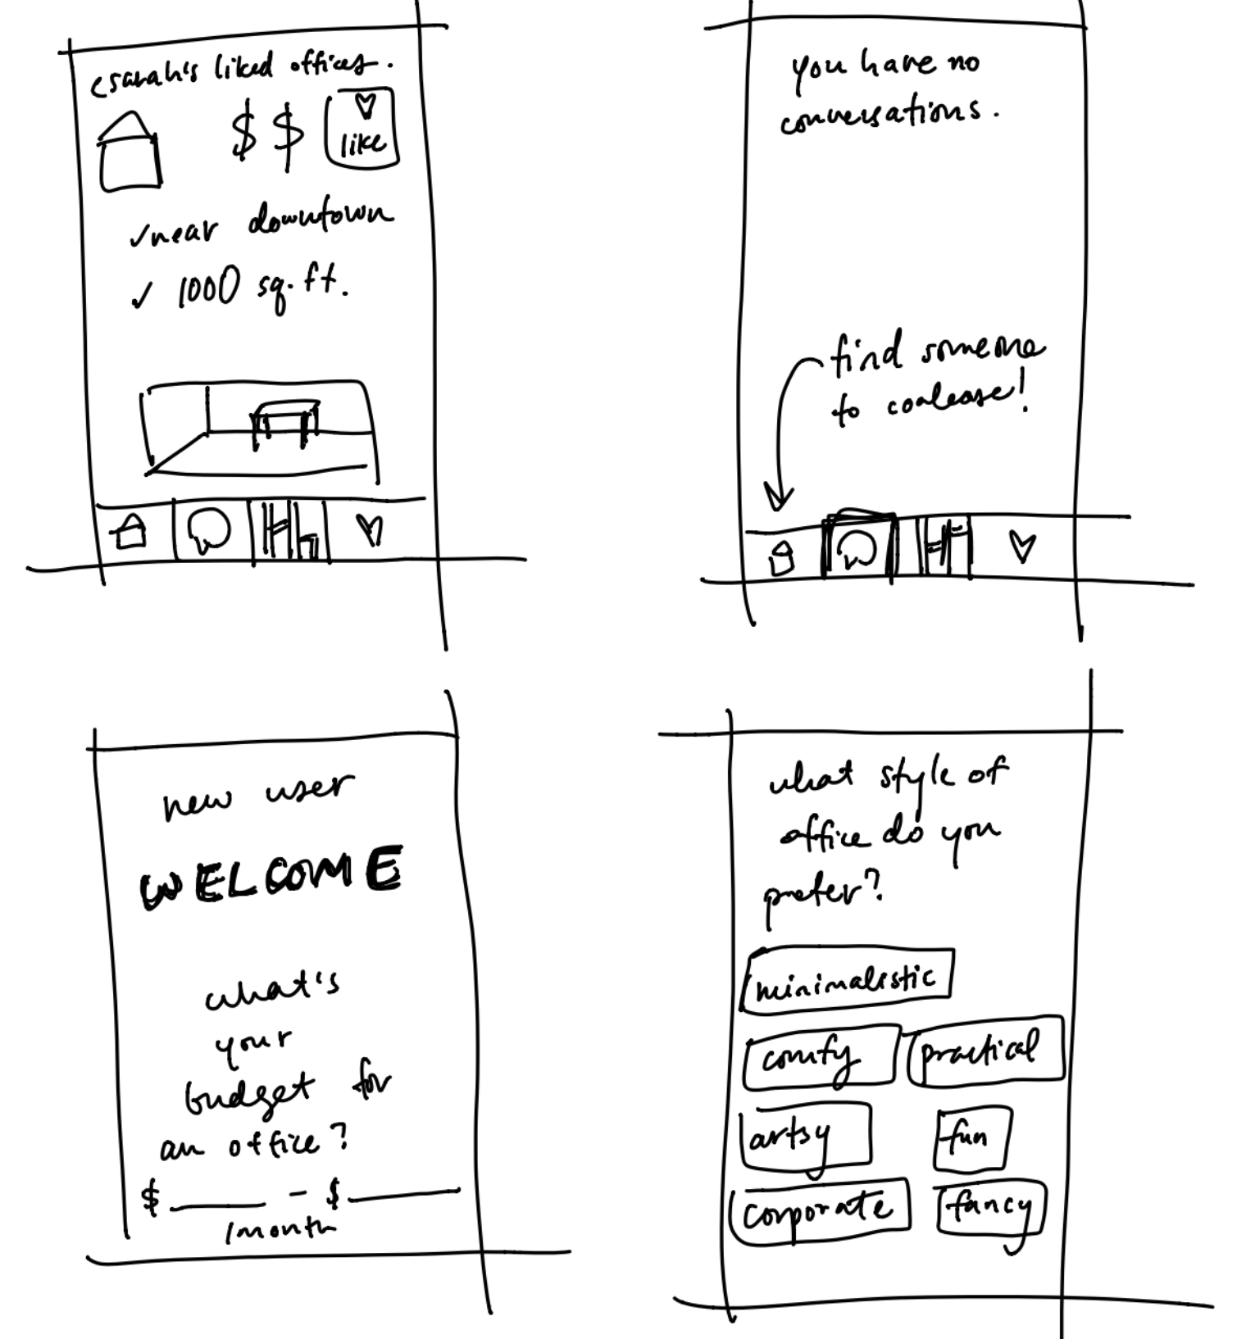
Low-fi Prototype Structure

Slide 7
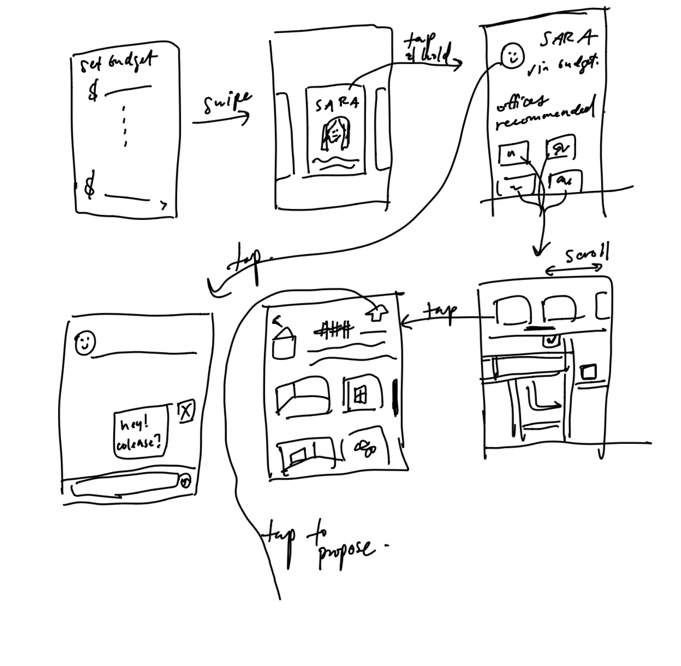
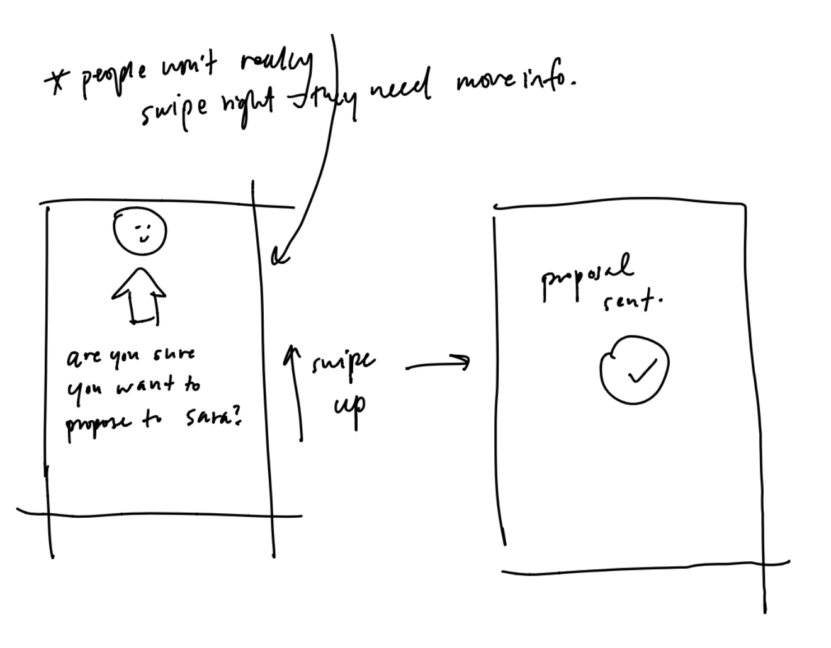
Task 1: Find Space to Rent & Set Budget

Slide 8
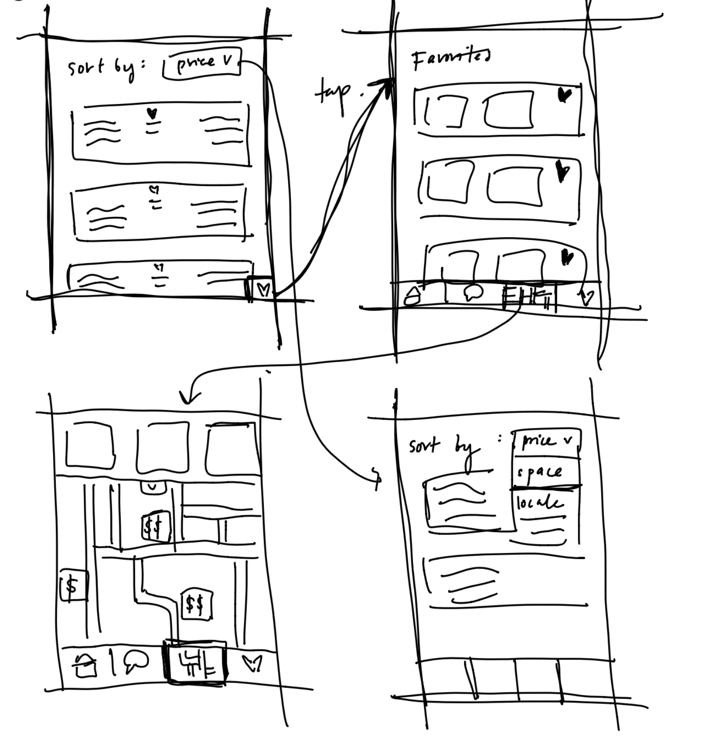
Task 2: Comparing Different Spaces

Slide 9
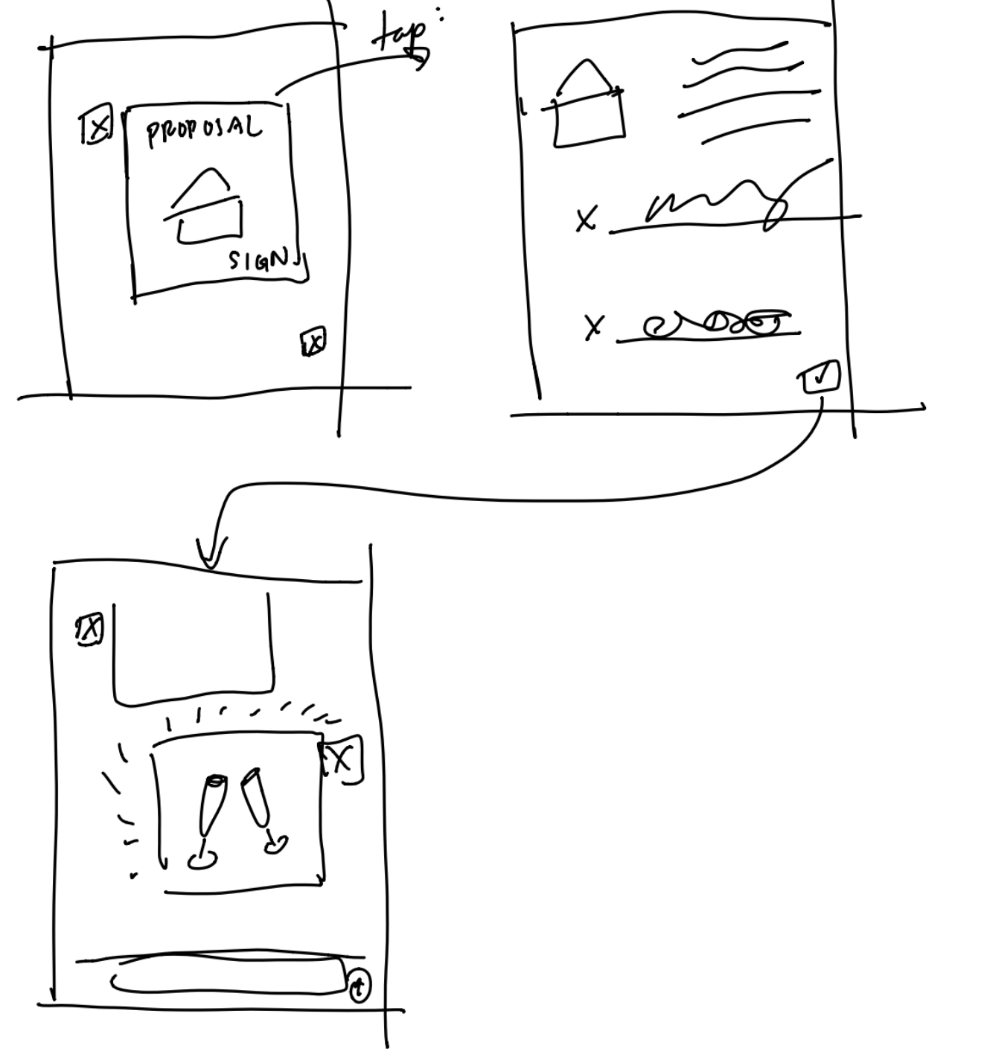
Task 3: Finalize and Sign Agreement

Slide 10
Experiment Environment
6 Tasks
Provided one task at a time to perform using our prototype in Marvel
Timed each task
Asked for detailed responses when walking through the app

Slide 11
Experiment Participants
Cameron
From Aspen, Colorado
Landscape Photographer
Young professional in the photography industry
Jessie
From Jacksonville, Florida
Portrait Photographer
More tenured professional in the photography industry with knowledge of gallery space
Abel
From Denver, Colorado
Graphic Designer
Has some experience with gallery spaces, but is well connected in the industry

Slide 12
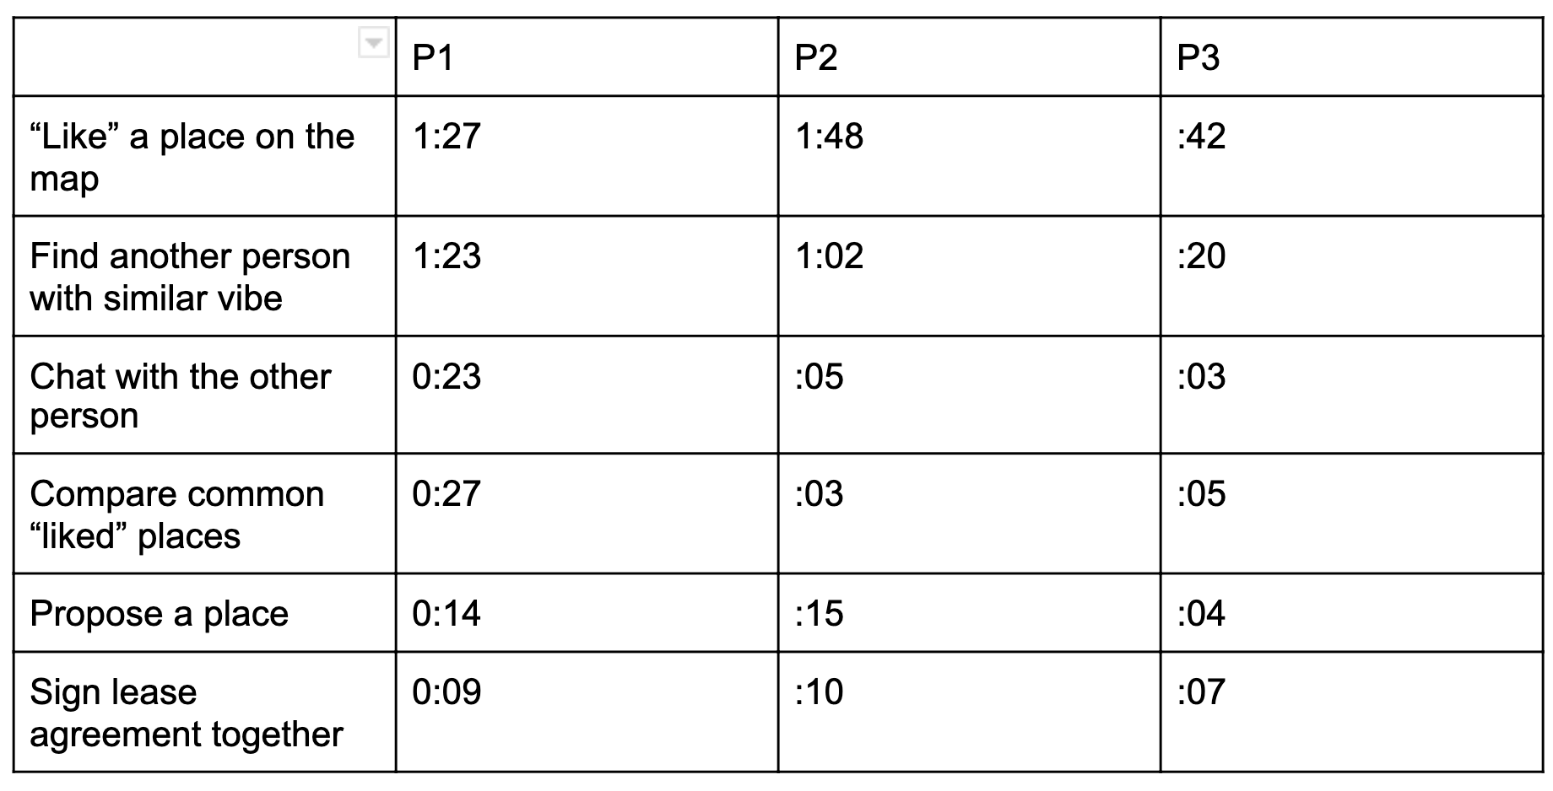
Experiment Results - Task Times
Successfully completed all tasks
Short completion times for simple tasks
LIKE a place on the map took more time to complete than other tasks indicating possible confusion

Slide 13
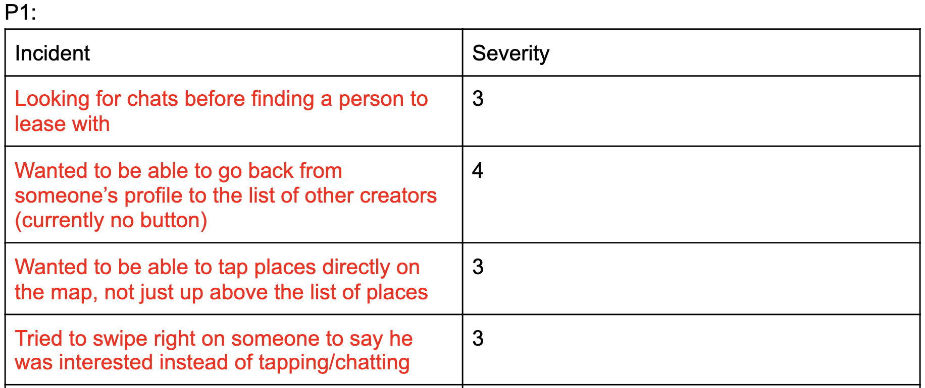
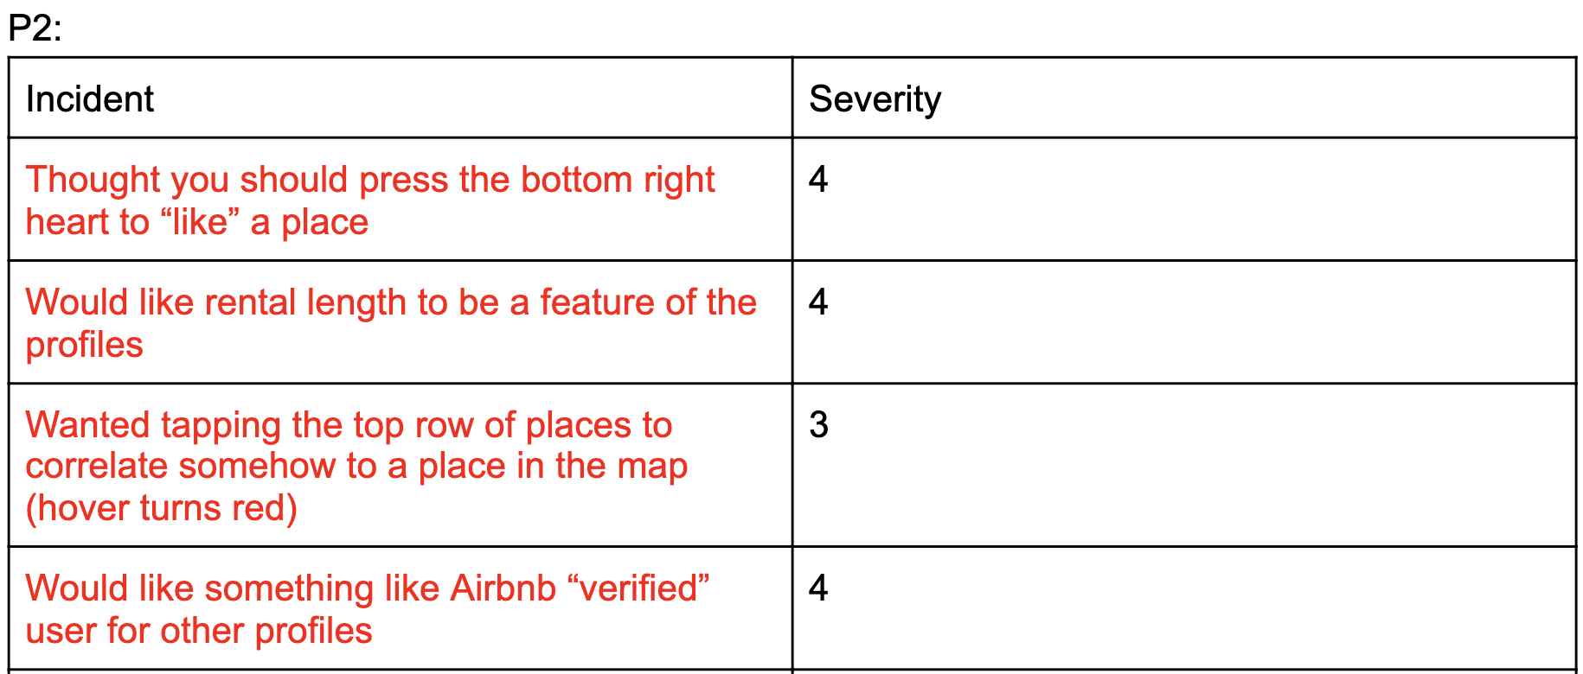
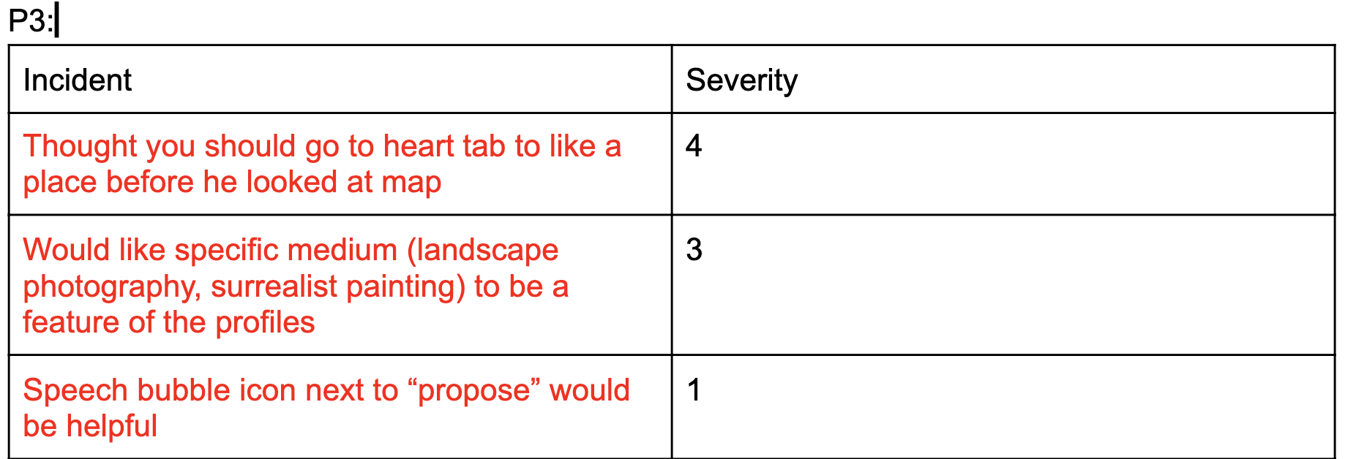
Experiment Results - Complaints
Unclear how to go about liking a place
Wanted different information on the cards
Confused on map functionality

Slide 14
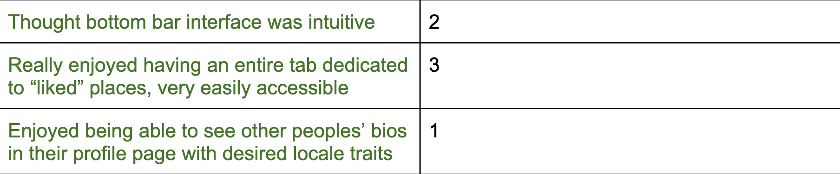
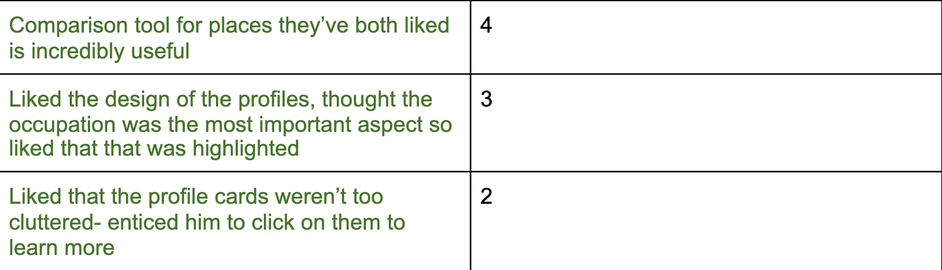
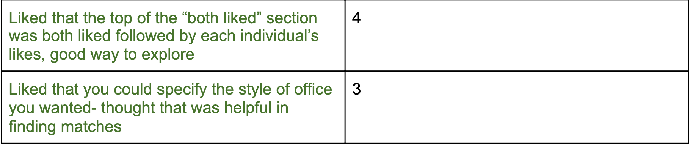
Experiment Results - Successes
Interface was intuitive
Found comparison for places both parties liked very helpful
Excited about the product and problem it solves for them

Slide 15
UI Changes
Change the heart button on the bottom to better reflect a profile vs a like button
Add back button from viewing profiles
Add updated card info

Slide 16
Summary
Users were excited about the product and stated it would simplify an archaic process
Map functionality and how to like a space were confusing points functionally

Slide 17
Thank You

Slide 18
CREDITS
Special thanks to all the people who made and released these awesome resources for free:
Presentation template by SlidesCarnival
Photographs by Unsplash
Illustrations by Pixsellz

